Slide 1
Unit 12
What did you do last weekend?
Section B 1a-1e
七年级下册

Slide 2

Objectives
To learn some phrases about weekend activities: study for a test, have dinner with friends, go to the library, fly a kite, swim in a swimming pool…
To learn the past simple irregular verbs: sang, flew, had, swam
To make a conversation about weekend activities

Slide 3

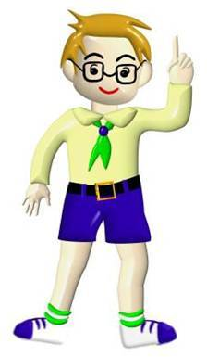
Describe what you did on your last weekend to your classmates.
My last weekend was interesting. I visited my grandparents. They lived in a small village. I fed the chickens and sheep. I went fishing with my grandpa.

Slide 4
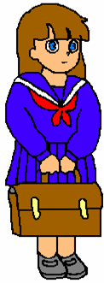
My last weekend was boring. I stayed at home and did my homework on Saturday. I went to the park on Sunday morning, but it rained. So we went home and watched TV.

Slide 5
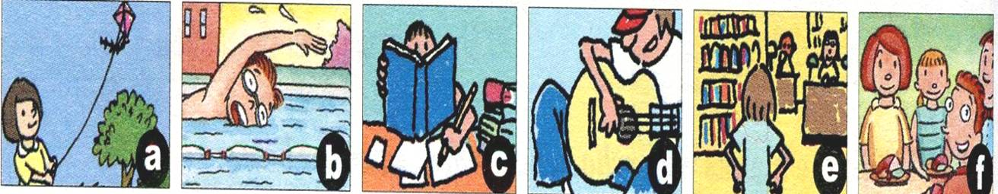
1a. Here are some things that Sally and Jim did yesterday. Match the activities with the pictures.

Slide 6
1.____ sang and played the guitar
2.____ studied for a test
3.____ had dinner with friends
4.____ went to the library
5.____ flew a kite
6.____ swam in a swimming pool
d
c
f
e
a
b

Slide 7
1b. Do you think the activities in 1a are fun? Draw a happy face ☺ or an unhappy
☹ under each picture.
☺
☺
☹
☺
☺
☺

Slide 8


1c. Listen. What did Sally and Jim do
last weekend? Complete the chart.
Sally
___________________
___________________
___________________
Jim
__________________________
_________________________
___________________________
did her homework
sang and played the guitar
studied for a test
flew a kite in the park
went to the library
had dinner with his friends

Slide 9
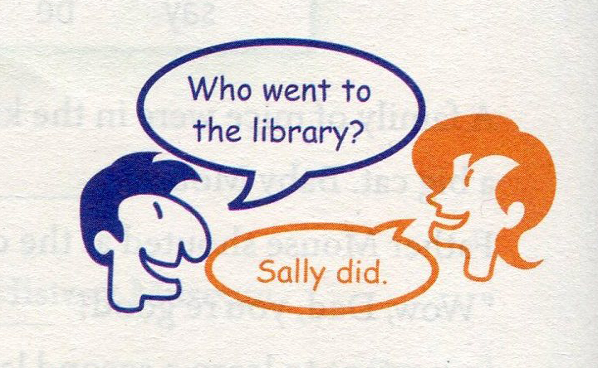
1d. Make a conversation with a partner.
Talk about what Sally and Jim did last
weekend.

Slide 10

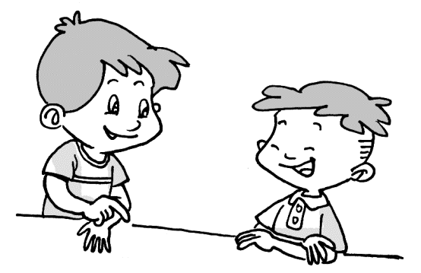
No, she didn’t. She did her homework and studied for a test.
Did Sally go out on Saturday?
Then what did she do on Sunday?
She went to the library.

Slide 11

How was Jim’s last weekend?
It was relaxing.
Really? What did he do on Saturday?
Well. He sang and played the guitar on Saturday morning.

Slide 12
Did Jim do his homework on Sunday?
No, he didn’t. He flew a kite in the park on Sunday afternoon.
What about Sunday evening?
Well, he had dinner with friends.

Slide 13
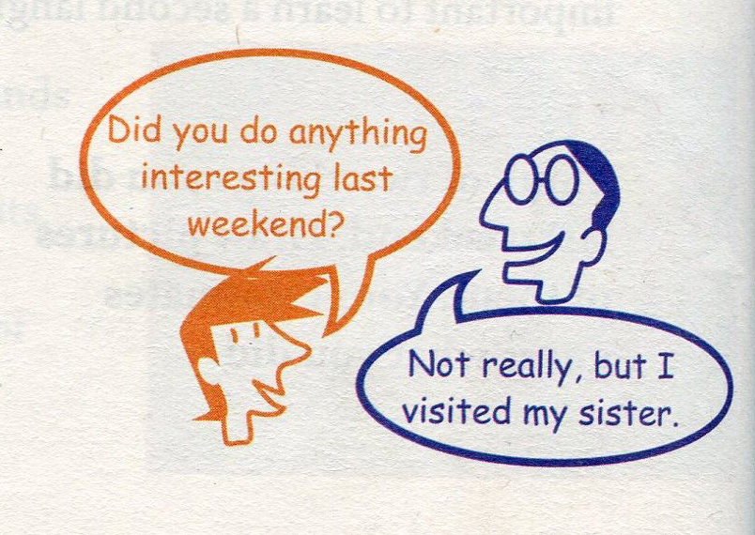
1e. Make a conversation . Ask what
your partner did last weekend.

Slide 14
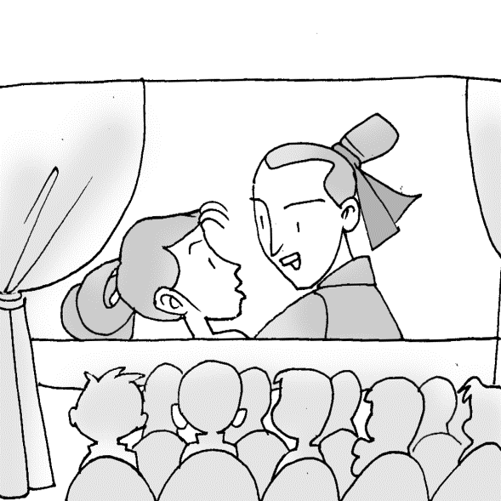
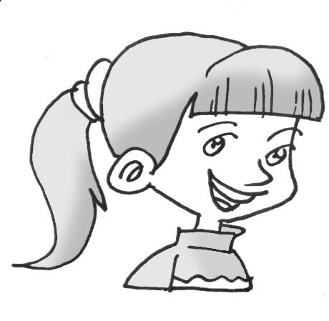
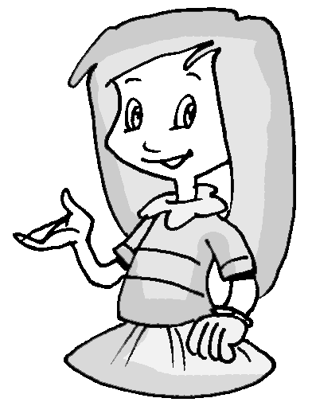
Hi, Alice. What did you do last weekend?
I went to the cinema with my friends.

Slide 15
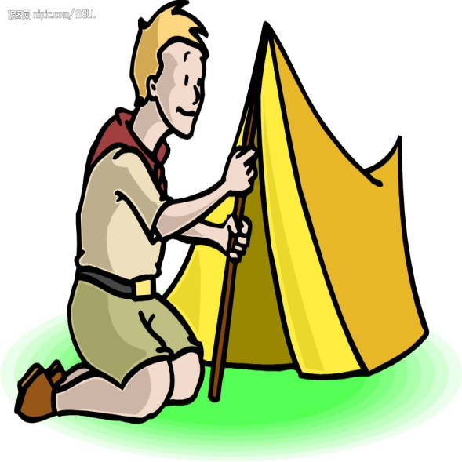
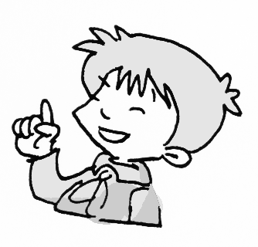
Hello, Bob. Did you go out last weekend?
Yes, I did. I camped by the lake with my uncle.

Slide 16

Language points
Did you do anything interesting last weekend?
上周末你做什么有趣的事情了吗？
形容词修饰something, anything, nothing等不定代词时，要放在这些不定代词的后面。如：

Slide 17


Come here! I have something important to tell you.
过来！我有一些重要的事要告诉你。
Practise
改错。
Sally wants to do different something this time.
something different

Slide 18
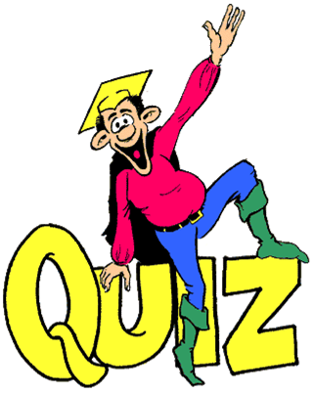

Slide 19

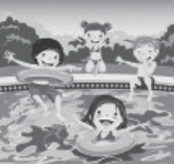
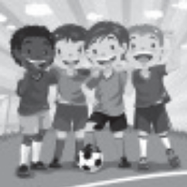
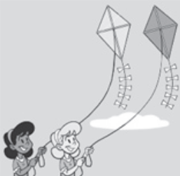

Ⅰ . 图文配对。
( ) 1. Li Lin went swimming with her friends last Saturday morning.
( ) 2. Wei Min stayed at home and studied for her English test last weekend.
( ) 3. Lucy and Lily had fun flying kites in the park.
( ) 4. Wang Wei played soccer with his classmates yesterday afternoon.
( ) 5. Chen Lei went to the music club and played the guitar there.
A
B
C
D
E

Slide 20
Ⅱ. 选择方框中适当的句子补全对话。
A. What about you, Dick?
B. Where did you go?
C. How was the beach?
D. How was your vacation?
E. I really enjoyed my vacation.
D
A: Hi, Mary! (1)________
B: It was great.
A: (2)________
B: I went to Sanya with my parents.
A: Did you go to the beach?
B: Yes, we did.
B

Slide 21
C
A: (3)________
B: It was beautiful. We played
volleyball and enjoyed the sunshine
on the beach. I also went swimming
in the sea. (4)________
A: That sounds good.
B: (5)________
A: I went to visit my uncle and aunt in
Shanghai. They took me to many
interesting places. I also had a good
time.
E
A

Slide 22

Homework
Read the conversation between Sally and Jim as many times as possible.

Slide 23
Thank You!

